Slide 1
Caring for the Soul
Ministering from Abundance
Djuna Dudeck, Arkansas
Kairos Inside
Nick Nixon, North Carolina Kairos Inside

Slide 2
Welcome!
Did you:
Sign In
Pick Up Handouts
Pick Up Praise and Polish
Notes:
Djuna

Slide 3
Djuna Dudeck
Vilonia, Arkansas
Kairos since 2018
Have been a Weekend Leader, AC Chair, State Secretary, and now I represent Arkansas on the International Council and the Communication Sub-Committee
I have 1 daughter, a son-in-law, and 2 fabulous granddaughters.
Notes:
Djuna

Slide 4
Nick’s Introduction
New Bern, North Carolina
I started serving KAIROS in 2018, served on the local AC and now I represent North Carolina on the International Council. I am on the KI Sub-committee.
I’ve two daughters and 4 grandchildren that keep me running from one event to another.
I am the Chaplain at a Medium security prison in North Carolina.
Notes:
Nick

Slide 5
Devotion: Psalm 23
23(2) He makes me lie down in green pastures
23(3) He Restores my soul
23(5) You prepare a table before me
  My cup overflows
Notes:
Nick-Read the entire Psalm. God is showing us that we are to rest and become refreshed until our cups overflow from the restoration of our souls.

Slide 6
What is self-care?
Soul Care
Soul Rest
Notes:
Nick-If we are continuously giving and giving without refilling our tank. There will come a time when you’ll feel burnt out, possibly start thinking negatively about ministries that we serve. The reason for our 3 on, 1 off is mutiny layers. It’s keeps us from becoming complacent, accepting things that are being done in a way that is “outside the riverbanks”. The 1 off allows us a year of rejuvenation and we should ALL take advantage of this important lesson.
Soul Care is the intentional practice of managing your mind, will, and emotions to keep them aligned with God's peace. It is the maintenance required to keep your internal "cup" full so that ministry flows from abundance, not deficit.
Soul Rest is the deliberate cessation of emotional labor, decision-making, and psychological output. It is not just sleeping (which is body rest); it is unplugging from the heavy empathetic burdens of prison ministry to allow your mind and emotions to reset.

Slide 7
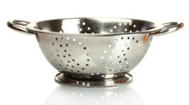
Why should we even self-care?
Notes:
Djuna-A friend of mine told me this illustration that a pastor taught him. What is this? (hold up colander) Yes, it’s a colander. What’s it’s purpose? To separate, to drain, etc. Let’s pretend that we are all colanders. Can we do our function or complete our purpose if something is not being poured into us? NO! A colander doesn’t work if nothing is being poured in-just as we cannot complete of mission or purpose if we are not being poured into. That is the purpose of self-care.

Slide 8
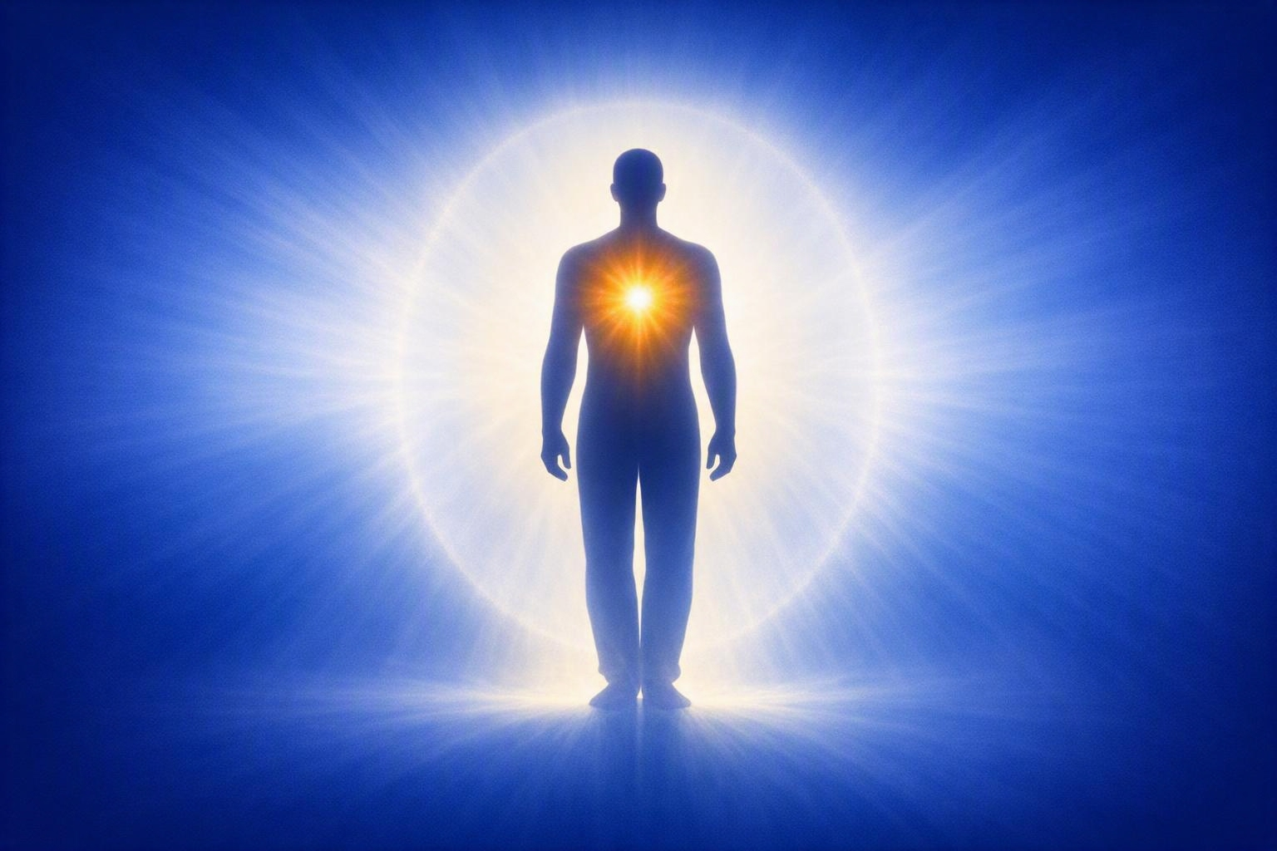
Anatomy of the Volunteer
The Body
  Physical Realm
The Spirit
  Divine Realm
The Soul
  Psychological Realm
Notes:
Djuna-To care for the volunteer holistically, we must distinguish between the three interconnected parts of human design:
The Body (Physical Realm): Your world-consciousness. It interacts with the physical environment through the five senses. In ministry, this is the vehicle that drives to the correctional facility, stands for hours on the compound, and physically bakes or delivers cookies.
The Spirit (Divine Realm): Your God-consciousness. It is the deepest part of a human, designed to commune with God, receive the Holy Spirit, and experience spiritual regeneration. In ministry, this is where you receive divine revelation, spiritual gifts, and the call to serve.
The Soul (Psychological Realm): Your self-consciousness. It consists of your mind (thoughts), will (decisions), and emotions (feelings). The soul is the bridge between your physical body and your spiritual convictions. When a volunteer experiences "burnout," it is primarily an exhaustion of the soul

Slide 9
Biblical Examples
Physical
  Matthew 11:28-30
  I Corinthians 6:19-20
Emotional/Mental
  Philippians 6:6-7
  Matthew 6:31-34
  Proverbs 17:22
Notes:
Nick-You need to take care of yourself physically, emotionally, and mentally. Physically Jesus tells in Matthew 11:28-30 to ²⁸ “Come to me, all you who are weary and burdened, and I will give you rest. ²⁹ Take my yoke upon you and learn from me, for I am gentle and humble in heart, and you will find rest for your souls. ³⁰ For my yoke is easy and my burden is light.” and in I Cor. 6:19-20 He says ¹⁹ Do you not know that your bodies are temples of the Holy Spirit, who is in you, whom you have received from God? You are not your own; ²⁰ you were bought at a price. Therefore honor God with your bodies. If we are to honor God with our bodies then we really should take care of them. Christ says in Philippians Do not be anxious about anything, but in every situation, by prayer and petition, with thanksgiving, present your requests to God. ⁷ And the peace of God, which transcends all understanding, will guard your hearts and your minds in Christ Jesus. He tells us that He will guard our hearts and minds. Matt 6 says ³¹ So do not worry, saying, ‘What shall we eat?’ or ‘What shall we drink?’ or ‘What shall we wear?’ ³² For the pagans run after all these things, and your heavenly Father knows that you need them. ³³ But seek first his kingdom and his righteousness, and all these things will be given to you as well. ³⁴ Therefore do not worry about tomorrow, for tomorrow will worry about itself. Each day has enough trouble of its own. I love the verse 34- it reminds me not to worry about tomorrow. I need that reminder daily. The Bible is full of examples about how to care for ourselves but the last one I want to share is Proverbs 17:22. A cheerful heart is good medicine, but a crushed spirit dries up the bones. If you are like me sometimes your bones feel dried up.

Slide 10
Jesus’ Self-Care
Intentional Solitude and Prayer
Resting Physical Body
Engaging in Community
Notes:
Nick-The few of the best examples Jesus gave us was when they where crossing the sea of Galilee, Jesus is sleeping with not a care in the world and all around him, His disciples are frantic as a ants in a thunderstorm. I believe Jesus was teaching his disciples what it meant to seek self-care and to trust that God would see to their every needs.

Slide 11
Jesus on Soul Care
The Source of Rest
  Matthew 11:28-30
The Value of the Soul
  Matthew 16:26
The Commandment Priority
  Mark 12:30
Notes:
Djuna-When Jesus spoke of the "soul" (psuche in Greek), He referred to your seat of life, mind, and emotions. Share these three specific texts with the room:
The Source of Rest (Matthew 11:28-30):
“Come to me, all you who are weary and burdened, and I will give you rest... you will find rest for your souls.”
Kairos Context: Jesus distinguishes between physical exhaustion and soul exhaustion. He promises a specific rest that fixes the "heavy baggage" we carry back across the prison threshold.
The Value of the Soul (Matthew 16:26):
“What good will it be for someone to gain the whole world, yet forfeit their soul?”
Kairos Context: Paraphrased for volunteers: What good is it if you convert the entire cell block, but lose your own peace, marriage, or mental health in the process? The soul of the volunteer matters as much to God as the soul of the resident.
The Commandment Priority (Mark 12:30):
“Love the Lord your God with all your heart and with all your soul and with all your mind and with all your strength.”
Kairos Context: Loving God with a healthy soul precedes loving your neighbor (the resident) effectively. A fractured soul produces fractured ministry.

Slide 12
How can we have self-care?
Intentional Solitude & Prayer
  Mark 1:35
Spend Time Alone
  Mark 6:31-32
Keep Up with Our Needs
  Matthew 15:32
Take Care of Our Bodies
  1 Corinthians 6:19-22
Notes:
Nick-We need to get away, find that place that brings you true fulfilling peace and just pray. Talk to the Father, He wants to know our struggles and troubles.
Honoring the body as a temple, recognizing your limits, and retreating to Christ for rest and renewal.
Attending church services, go to be filled with the Word and not to serve (too often we go to church and serve others, rather than be served, take a break and let others love on you.
Hobbies that bring you peace, I find my greatest peace when I’m working in my woodshop or trimming our crazy knockout roses.

Slide 13
Program-Specific Advantages of Soul Care
Kairos Branch | The Ministry Context | Direct Advantage of a Restored Soul
Kairos Inside | High-security, institutional, and emotionally charged prison environments. | Unshakeable Discernment: A healthy soul allows you to remain empathetic without absorbing the institutional anxiety, manipulation, or heavy spiritual darkness of the compound.
Kairos Outside | Supporting the deeply traumatized female family members of the incarcerated. | Infinite Emotional Depth: Women attending these weekends require intense emotional safety. A volunteer with an abundant soul can offer genuine, unhurried presence rather than superficial comfort.
Kairos Torch | Mentoring highly vulnerable, guarded, and volatile incarcerated youth. | Radical Patience & Consistency: Youth can spot a tired, frustrated adult instantly. Soul care provides the emotional resilience needed to handle rejection or behavioral outbursts with unconditional love.
Notes:
Nick-

Slide 14
Self-Care in Kairos
The “3-on, 1-off” Policy
Emotional Decompression
Holy Delegation
Scriptural Guardrails
Notes:
Djuna-Practical Disciplines for Soul Care
The "3-on, 1-off" Policy: Strictly adhere to the Kairos rotation guideline. After serving on three consecutive weekend teams, step away for at least one full cycle. Use this time strictly to receive, not give.
Emotional Decompression: Establish a 24-hour "silence or low-stimulus" boundary immediately following a Kairos Inside or Torch weekend to process the heavy emotional atmosphere of a correctional facility.
Holy Delegation: Intentionally step back to provide space for new volunteers to lead. Recognize that holding onto a ministry role indefinitely starves others of their calling and accelerates your own burnout.
Scriptural Guardrails: Guard your mind by replacing the trauma stories heard inside the prison walls with scripture meditation (e.g., Philippians 4:8) during your drive home.

Slide 15
Scriptural Responses to Push Back
The “I’m Indispensable Argument”
  Exodus 18:17-18
The “Guilt-Driven Serving” Argument
  Mark 6:30-31
The “Grit Over Grace” Argument
  1 Kings 19:4-7
Notes:
Djuna-Veteran volunteers often resist taking their mandatory time off. Use these biblical counters when leaders say, "If I don't do it, who will?" or "The harvest is plentiful, so I must keep pushing."
The "I'm Indispensable" Argument: "The facility needs my specific experience, and the team is short-handed."
Scriptural Response: Exodus 18:17-18. Jethro tells Moses, “What you are doing is not good. You and these people who come to you will only wear yourselves out. The work is too heavy for you; you cannot handle it alone.”
Kairos Application: Refusing to step down does not make you a hero; it makes you a bottleneck. Moses had to delegate to save his life and the nation. Your rest forces the team to identify and train the next generation of leaders.
The "Guilt-Driven Serving" Argument: "I feel guilty resting when there are still lost souls inside that prison compound."
Scriptural Response: Mark 6:30-31. After the apostles did intense ministry, Jesus said, “‘Come with me by yourselves to a quiet place and get some rest.’ For so many people were coming and going that they had no even time to eat.”
Kairos Application: Jesus commanded rest while the crowds were still starving and desperate. He did not prioritize the crowd's immediate demand over His disciples' baseline health. If Jesus permits you to stop serving, you must permit yourself to stop.
The "Grit Over Grace" Argument: "God gives me supernatural strength; I don't get burned out."
Scriptural Response: 1 Kings 19:4-7. Elijah was spiritually powerful but became suicidal from exhaustion. God did not send a spiritual lecture; He sent an angel with food and a mandate to sleep.
Kairos Application: You are a spirit, but you live in a physical body with a psychological soul. Supernatural anointing does not override your basic biological and emotional design. God orders naps and snacks for exhausted giants of the faith

Slide 16
Managing the Transition Home:
The 48-Hour Protocol
The “Silent Windshield” Rule
The “Gate Pass” Mental Drop
Set Expectations with Family Ahead of Time
The 24-Hour Stimulus Fast
Notes:
Djuna-Managing the Transition Home: The 48-Hour Protocol
Exiting a prison yard (Kairos Inside/Torch) or a high-trauma room (Kairos Outside) causes an abrupt shift in environment. This protocol helps volunteers decompress without offloading tension onto family members.
The "Silent Windshield" Rule (First 60 Minutes):
Do not immediately turn on high-energy music, news, or podcasts on the drive home.
Drive the first 30 to 60 minutes in complete silence. This allows your brain to shift out of the hyper-vigilant state required inside a correctional facility.
The "Gate Pass" Mental Drop:
As you drive past the final security checkpoint or facility sign, pray a definitive prayer: "Father, I leave the residents in Your hands. I step out of my role as their minister and step back into my role as a spouse/parent/friend. They belong to You."
Set Expectations with Family Ahead of Time:
Send a text before you walk through your front door: "The weekend was powerful but heavy. My soul is full, but my tank is physically and emotionally empty. I need about an hour of quiet time to shower and unpack before I can talk about it."
The 24-Hour Stimulus Fast (Monday):
Avoid watching intense, violent movies or scrolling through polarizing news channels the day after a weekend. Your emotional nervous system is highly sensitive; fill it with peace, nature, and quiet environments.

Slide 17
What suggestions/comments do you have when it comes to self-care?
What questions do you have?
Notes:
Nick

Slide 18
GOD BLESS!!!
Djuna Dudeck
Nick Nixon
Notes:
Nick-Close in Prayer

